Slide 1
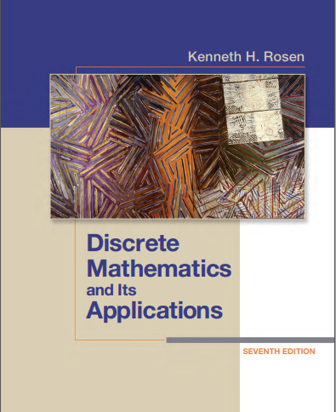

Discrete structures
By Dr. sajid iqbal
Course Reference Book

Slide 2
Predicates and quantifiers
Chapter - 1

Slide 3
Background
Propositions studied till now can not express all the statements
Example:
“Every computer connected to the university network is functioning properly”
“There is a computer on the university network that is under attack by an intruder.”
We need more of logic to express above statements mathematically

Slide 4
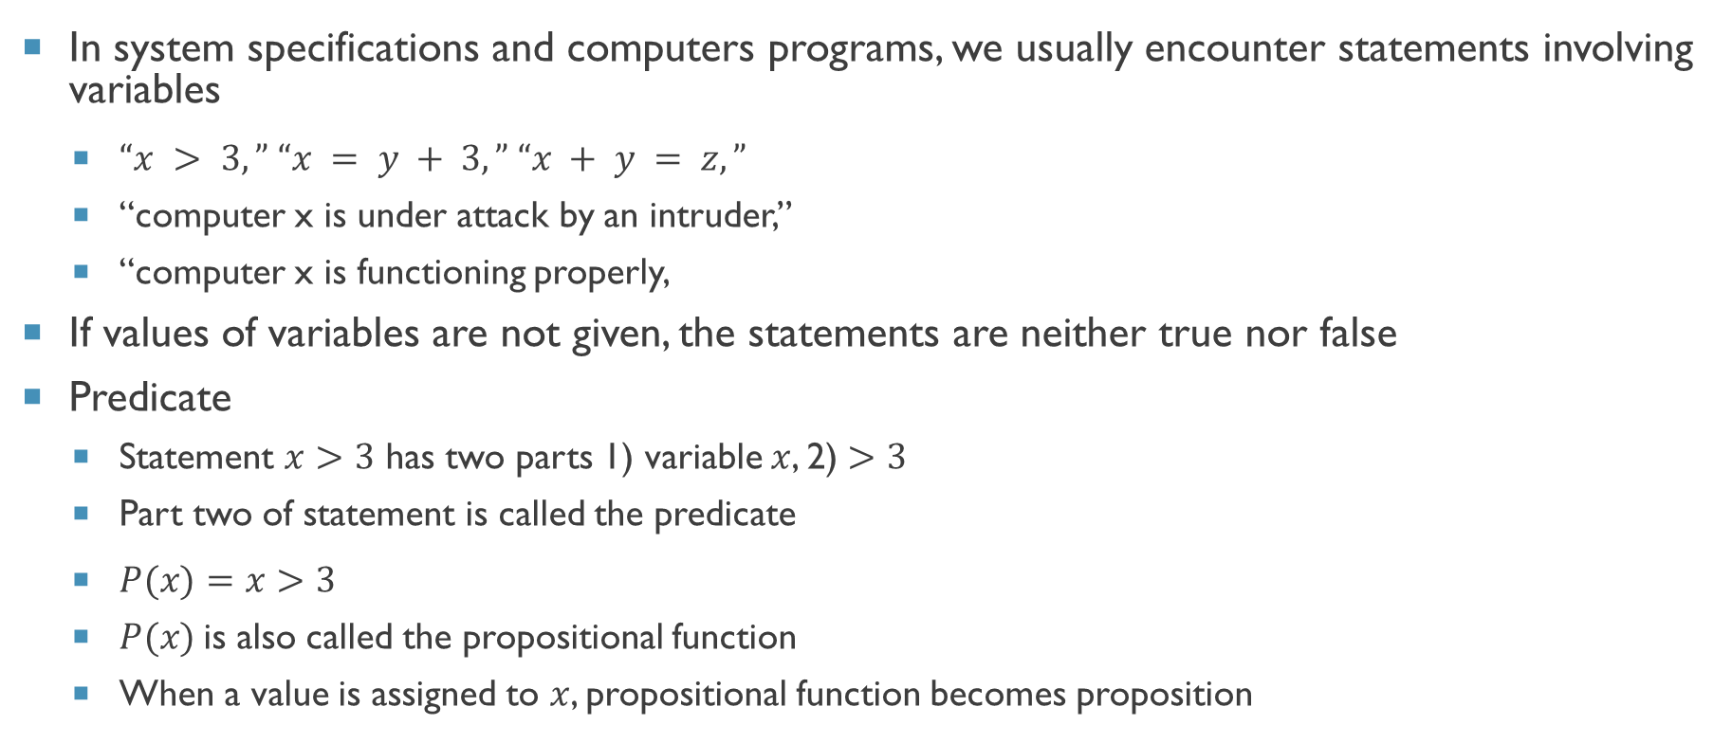
Predicates
In system specifications and computers programs, we usually encounter statements involving variables
$“x > 3,” “x = y + 3,” “x + y = z,”$
“computer x is under attack by an intruder,”
“computer x is functioning properly,
If values of variables are not given, the statements are neither true nor false
Predicate
Statement $x>3$ has two parts 1) variable $x$, 2) $>3$
Part two of statement is called the predicate
$P(x)=x>3$
$P(x)$is also called the propositional function
When a value is assigned to $x$, propositional function becomes proposition

Slide 5
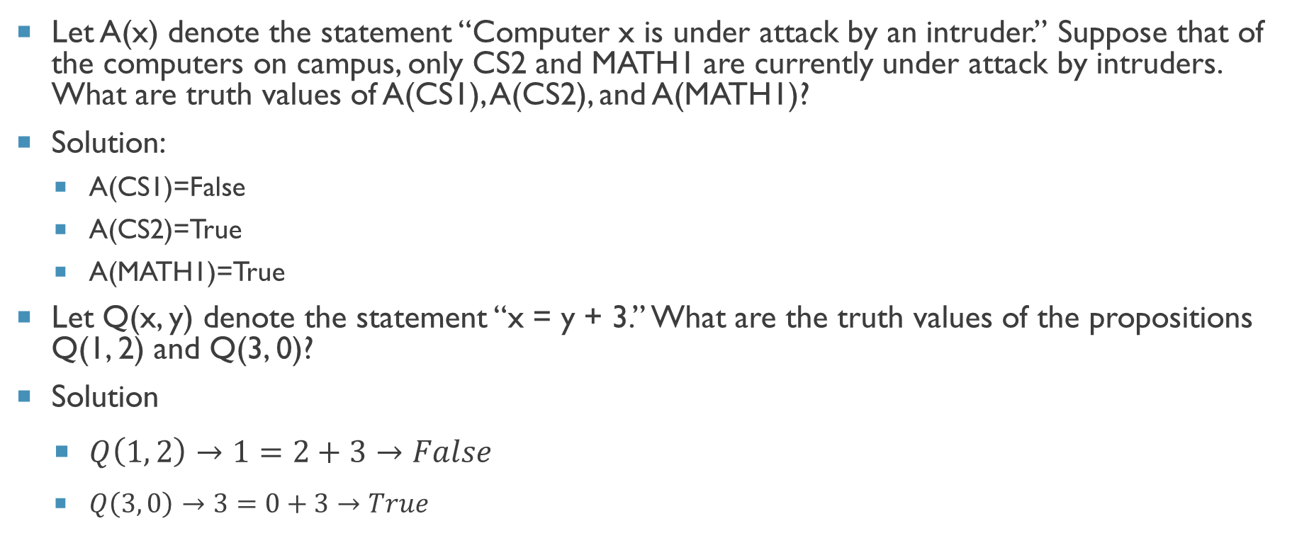
Propositional function - examples
Let A(x) denote the statement “Computer x is under attack by an intruder.” Suppose that of the computers on campus, only CS2 and MATH1 are currently under attack by intruders. What are truth values of A(CS1), A(CS2), and A(MATH1)?
Solution:
A(CS1)=False
A(CS2)=True
A(MATH1)=True
Let Q(x, y) denote the statement “x = y + 3.” What are the truth values of the propositions Q(1, 2) and Q(3, 0)?
Solution
$Q\left(1, 2\right)→1=2+3→False$
$Q\left(3, 0\right)→3=0+3→True$

Slide 6
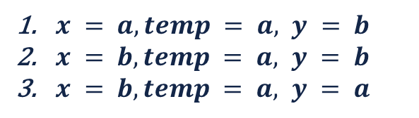
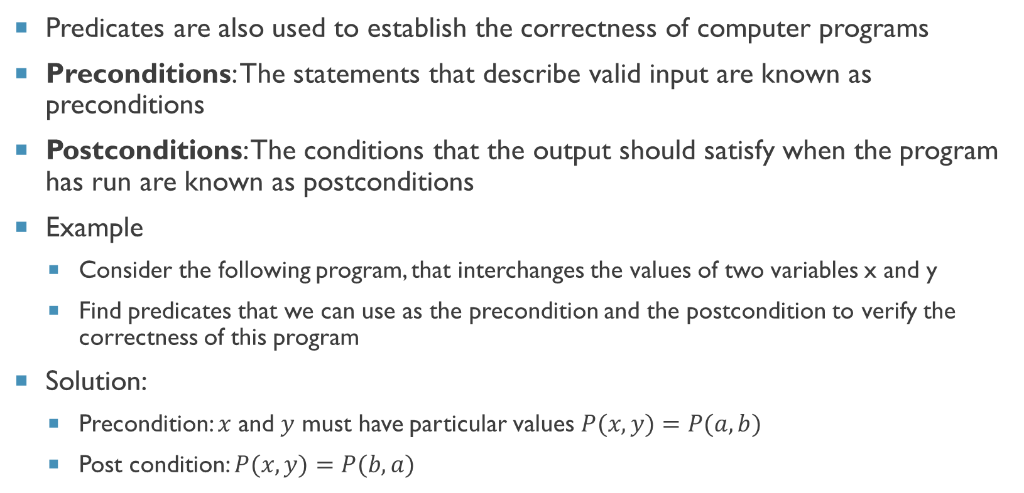

Preconditions and postconditions
Predicates are also used to establish the correctness of computer programs
Preconditions: The statements that describe valid input are known as preconditions
Postconditions: The conditions that the output should satisfy when the program has run are known as postconditions
Example
Consider the following program, that interchanges the values of two variables x and y
Find predicates that we can use as the precondition and the postcondition to verify the correctness of this program
Solution:
Precondition: $x$ and $y$ must have particular values $P(x,y)=P(a,b)$
Post condition: $P(x,y)=P(b,a)$
temp := x
x := y
y := temp
$x = a, temp = a, y = b$
$x = b, temp = a, y = b$
$x = b, temp = a, y = a$
$$P(x,y)=P(b,a)$$

Slide 7


Quantifiers
Quantification is the process to create a proposition from a propositional function
Quantification expresses the extent to which a predicate is true over a range of elements
Two types of quantifications
Universal quantification: a predicate is true for every element under consideration
Existential quantification: there is one or more element under consideration for which the predicate is true
predicate calculus : It is the area of mathematics that deals with predicates and quantifiers
$$for all →$$
$$there exists →$$

Slide 8
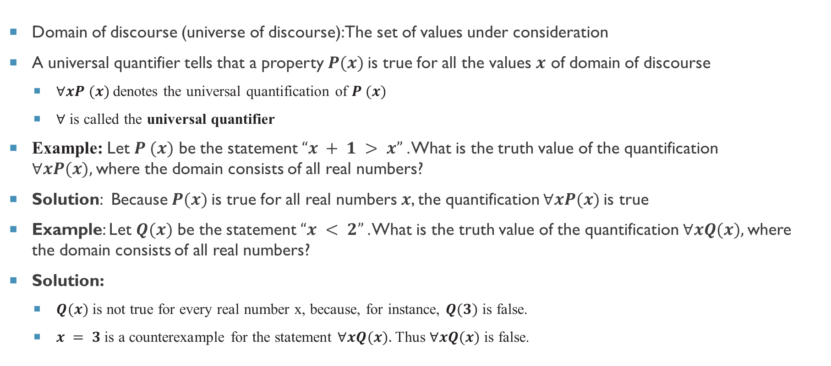
The Universal quantifier
Domain of discourse (universe of discourse): The set of values under consideration
A universal quantifier tells that a property $P(x)$is true for all the values $x$ of domain of discourse
$∀xP (x)$denotes the universal quantification of $P (x)$
$∀$ is called the universal quantifier
Example: Let $P (x)$ be the statement $“x + 1 > x”$. What is the truth value of the quantification $∀xP(x),$where the domain consists of all real numbers?
Solution: Because $P(x)$is true for all real numbers $x$, the quantification $∀xP(x)$is true
Example: Let $Q(x)$ be the statement $“x < 2”$. What is the truth value of the quantification $∀xQ(x),$where the domain consists of all real numbers?
Solution:
$Q(x)$ is not true for every real number x, because, for instance, $Q(3)$ is false.
$x = 3$is a counterexample for the statement $∀xQ(x).$Thus $∀xQ(x)$is false.

Slide 9
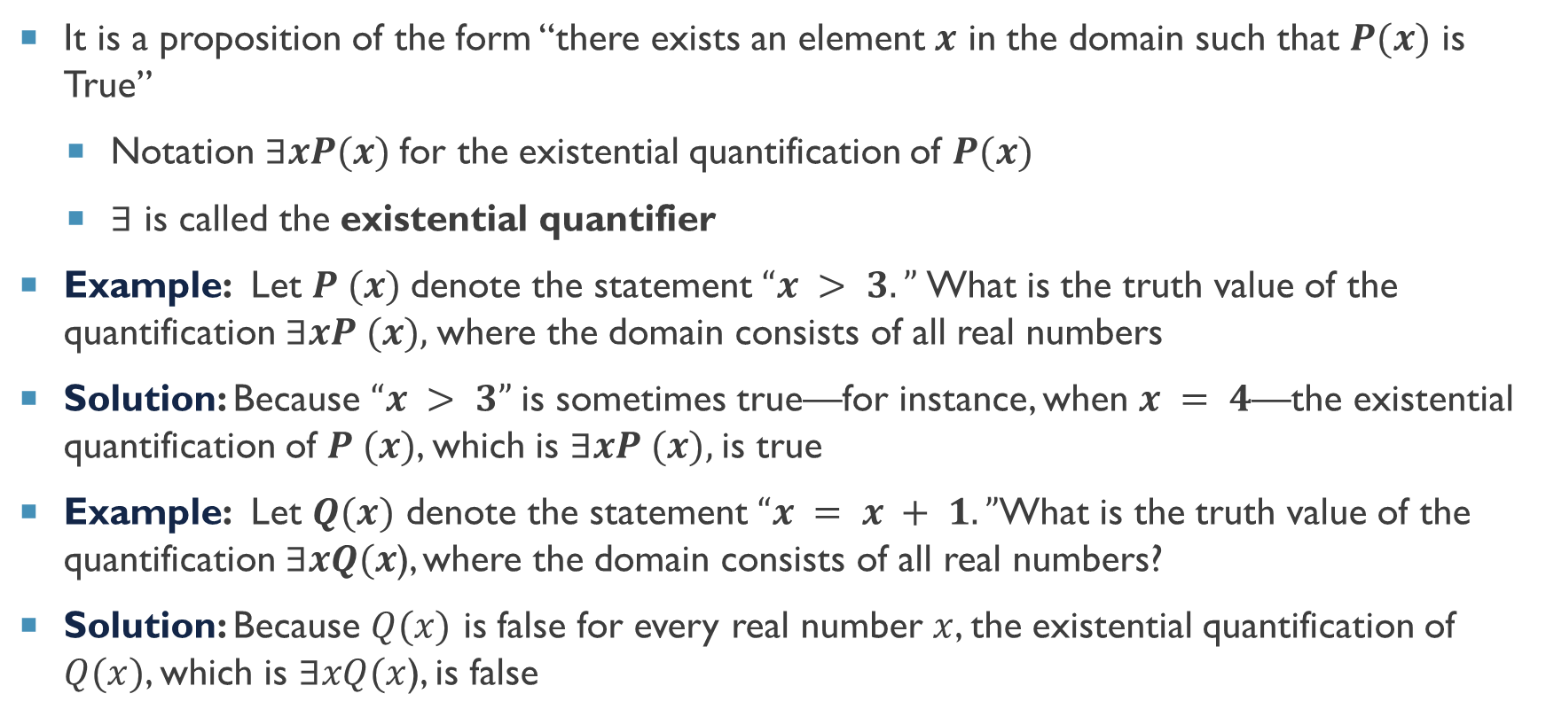
The existential quantifier
It is a proposition of the form “there exists an element $x$ in the domain such that $P(x)$ is True”
Notation $∃xP(x)$for the existential quantification of $P(x)$
$∃$ is called the existential quantifier
Example: Let $P (x)$denote the statement $“x > 3.”$What is the truth value of the quantification $∃xP (x),$where the domain consists of all real numbers
Solution: Because $“x > 3”$is sometimes true—for instance, when $x = 4$—the existential quantification of $P (x)$, which is $∃xP (x),$is true
Example: Let $Q(x)$ denote the statement $“x = x + 1.”$What is the truth value of the quantification$∃xQ(x$), where the domain consists of all real numbers?
Solution: Because $Q(x)$ is false for every real number $x$, the existential quantification of $Q(x)$, which is $∃xQ(x$), is false

Slide 10
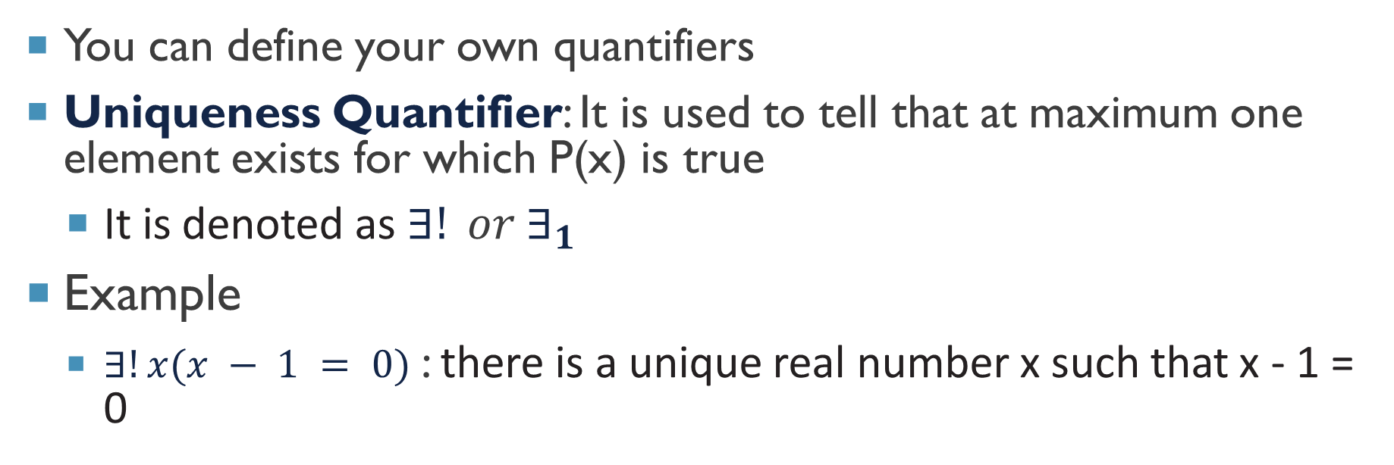
The unique quantifier
You can define your own quantifiers
Uniqueness Quantifier: It is used to tell that at maximum one element exists for which P(x) is true
It is denoted as $∃! or ∃_{1}$
Example
$∃!x(x − 1 = 0)$: there is a unique real number x such that x - 1 = 0

Slide 11
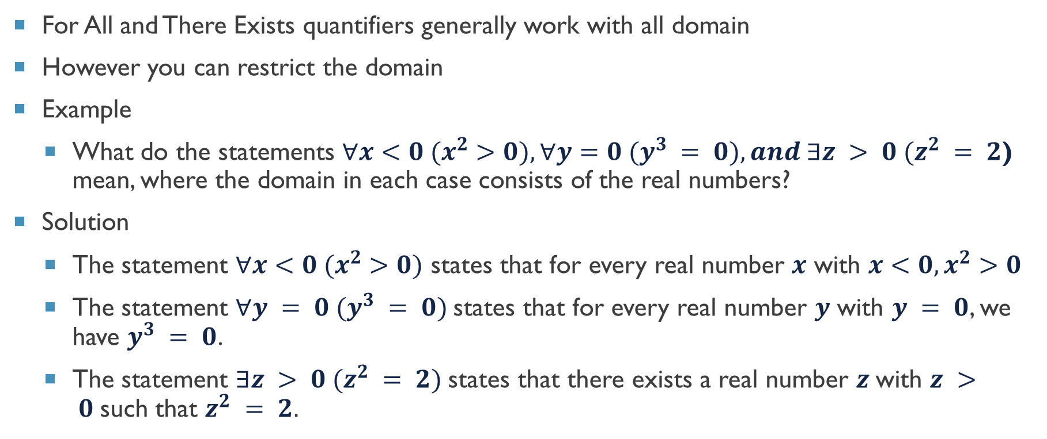
Quantifiers with restricted domains
For All and There Exists quantifiers generally work with all domain
However you can restrict the domain
Example
What do the statements $∀x<0 (x^{2}>0), ∀y=0 (y^{3} = 0), and ∃z > 0 (z^{2} = 2$) mean, where the domain in each case consists of the real numbers?
Solution
The statement $∀x<0 (x^{2}>0)$ states that for every real number $x$ with $x<0, x^{2}>0$
The statement $∀y = 0 (y^{3} = 0)$states that for every real number $y$ with $y = 0$, we have $y^{3} = 0$.
The statement $∃z > 0 (z^{2} = 2)$states that there exists a real number $z$with $z > 0$such that $z^{2} = 2.$

Slide 12
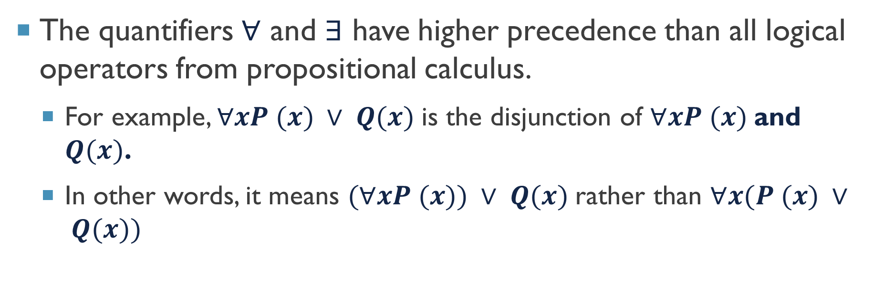
Precedence of quantifiers
The quantifiers $∀$ and $∃$ have higher precedence than all logical operators from propositional calculus.
For example, $∀xP (x) ∨ Q(x)$is the disjunction of $∀xP (x)$and $Q(x)$.
In other words, it means $(∀xP (x)) ∨ Q(x)$rather than $∀x(P (x) ∨ Q(x))$

Slide 13
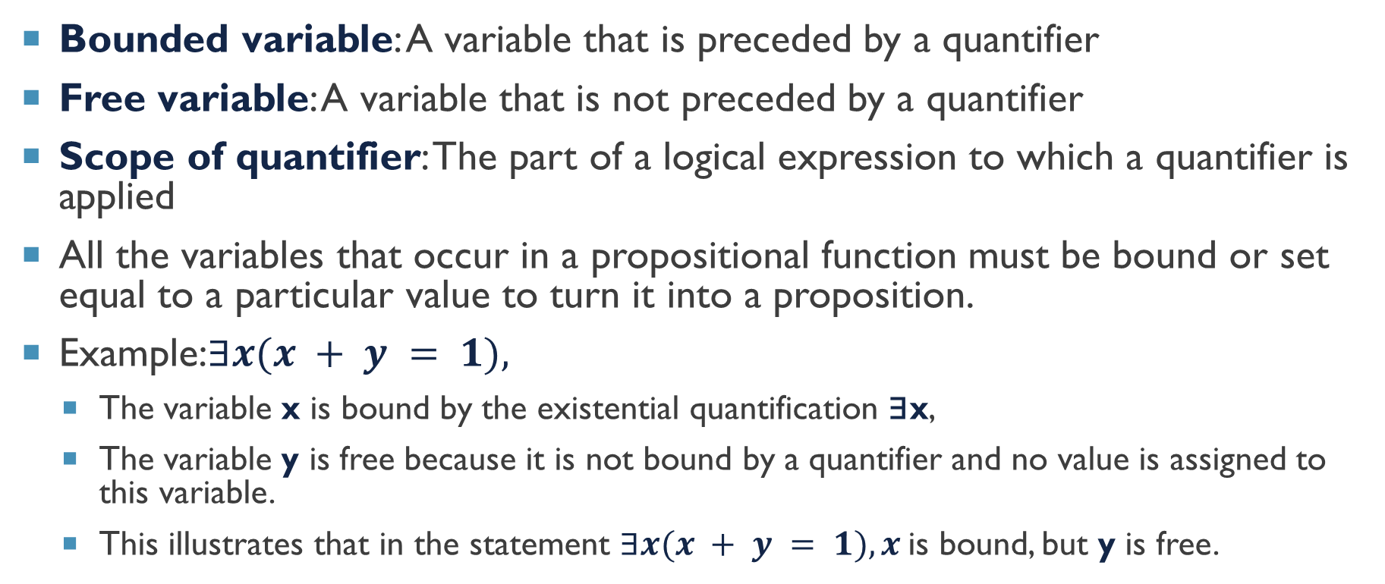
Binding variables
Bounded variable: A variable that is preceded by a quantifier
Free variable: A variable that is not preceded by a quantifier
Scope of quantifier: The part of a logical expression to which a quantifier is applied
All the variables that occur in a propositional function must be bound or set equal to a particular value to turn it into a proposition.
Example:$∃x(x + y = 1),$
The variable x is bound by the existential quantification ∃x,
The variable y is free because it is not bound by a quantifier and no value is assigned to this variable.
This illustrates that in the statement $∃x(x + y = 1), x$is bound, but y is free.

Slide 14
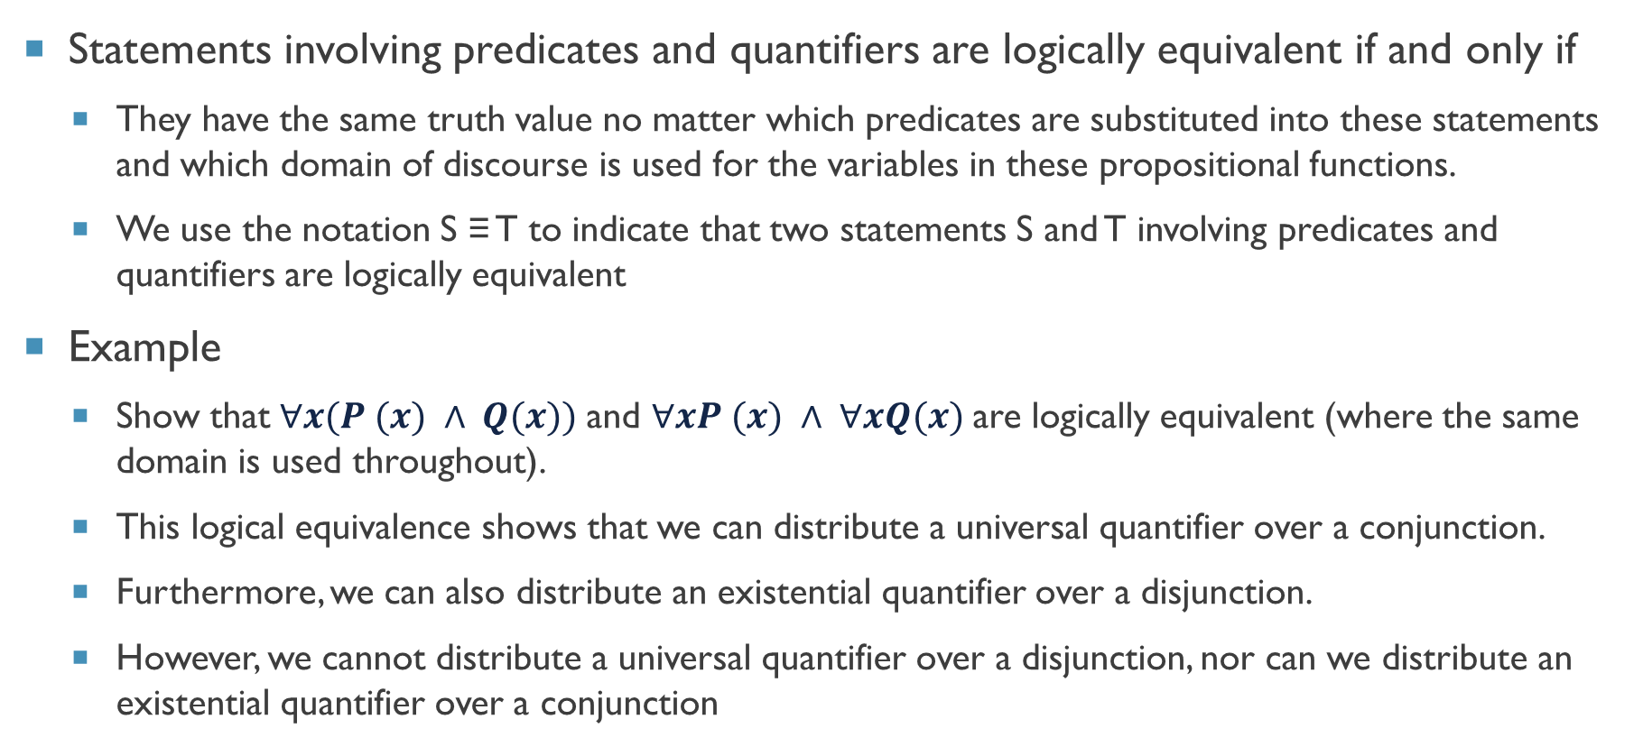
Logical equivalence with quantifiers
Statements involving predicates and quantifiers are logically equivalent if and only if
They have the same truth value no matter which predicates are substituted into these statements and which domain of discourse is used for the variables in these propositional functions.
We use the notation S ≡ T to indicate that two statements S and T involving predicates and quantifiers are logically equivalent
Example
Show that $∀x(P (x) ∧ Q(x))$and $∀xP (x) ∧ ∀xQ(x)$are logically equivalent (where the same domain is used throughout).
This logical equivalence shows that we can distribute a universal quantifier over a conjunction.
Furthermore, we can also distribute an existential quantifier over a disjunction.
However, we cannot distribute a universal quantifier over a disjunction, nor can we distribute an existential quantifier over a conjunction

Slide 15
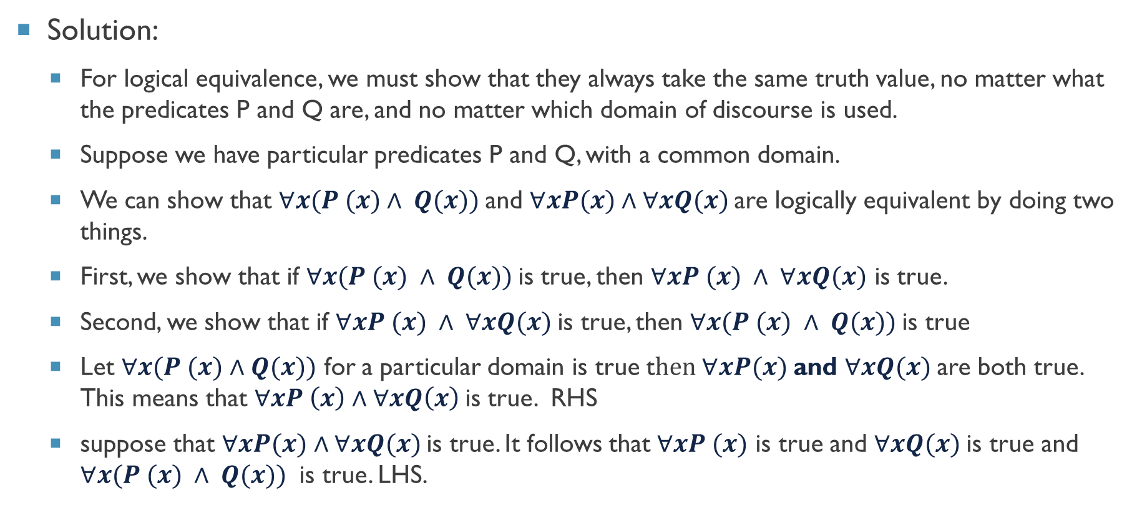
Logical equivalence with quantifiers
Solution:
For logical equivalence, we must show that they always take the same truth value, no matter what the predicates P and Q are, and no matter which domain of discourse is used.
Suppose we have particular predicates P and Q, with a common domain.
We can show that $∀x(P (x)∧ Q(x))$and $∀xP(x)∧∀xQ(x)$are logically equivalent by doing two things.
First, we show that if $∀x(P (x) ∧ Q(x))$is true, then $∀xP (x) ∧ ∀xQ(x)$ is true.
Second, we show that if $∀xP (x) ∧ ∀xQ(x)$is true, then $∀x(P (x) ∧ Q(x))$is true
Let $∀x(P (x)∧Q(x))$ for a particular domain is true t$hen ∀xP(x)$and $∀xQ(x)$are both true. This means that $∀xP \left(x\right)∧∀xQ\left(x\right)$is true. RHS
suppose that $∀xP(x)∧∀xQ(x)$is true. It follows that $∀xP (x)$ is true and $∀xQ(x)$is true and $∀x(P (x) ∧ Q(x))$ is true. LHS.
$$∀x(P (x) ∧ Q(x)) ≡ ∀xP (x) ∧ ∀xQ(x)$$

Slide 16
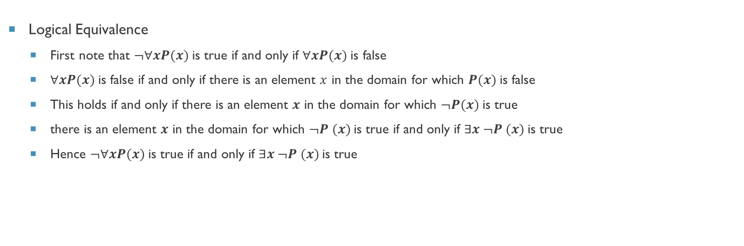
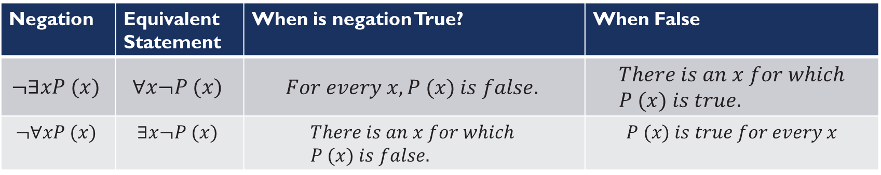
Negating quantified expressions
Logical Equivalence
First note that $¬∀xP(x)$is true if and only if $∀xP(x)$is false
$∀xP(x)$is false if and only if there is an element $x$ in the domain for which $P(x)$is false
This holds if and only if there is an element $x$ in the domain for which $¬P(x)$is true
there is an element $x$ in the domain for which $¬P (x)$is true if and only if $∃x ¬P (x)$is true
Hence $¬∀xP(x)$is true if and only if $∃x ¬P (x)$is true
$$¬∀xP (x) ≡ ∃x ¬P (x)$$
Negation | Equivalent Statement | When is negation True? | When False
$$¬∃xP (x)$$ | $$∀x¬P (x)$$ | $$For every x, P (x) is false.$$ | $$There is an x for which \\ P (x) is true.$$
$$¬∀xP (x)$$ | $$∃x¬P (x)$$ | $$There is an x for which \\ P (x) is false.$$ | $$P (x) is true for every x$$

Slide 17
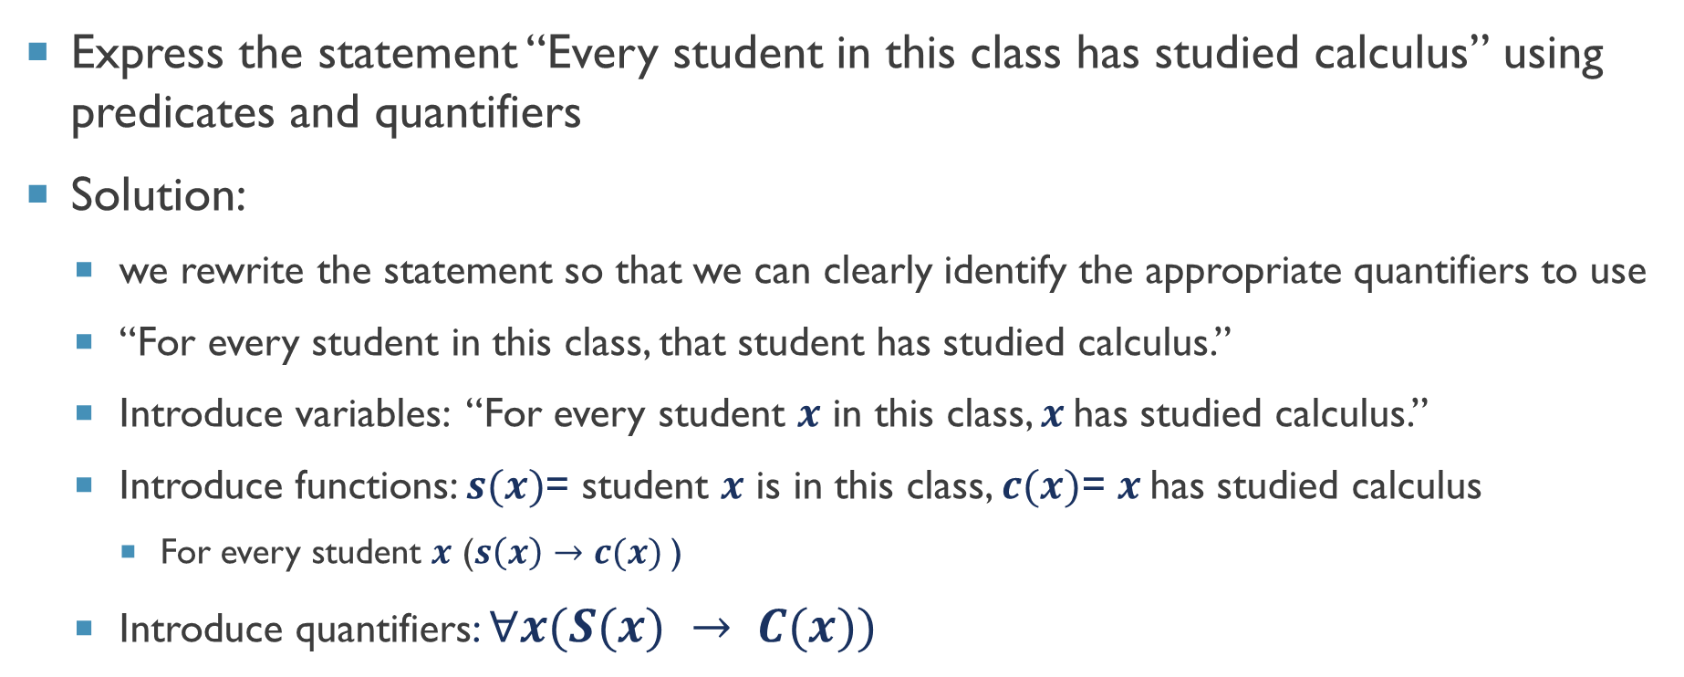
Translating from English into logical expressions
Express the statement “Every student in this class has studied calculus” using predicates and quantifiers
Solution:
we rewrite the statement so that we can clearly identify the appropriate quantifiers to use
“For every student in this class, that student has studied calculus.”
Introduce variables: “For every student $x$ in this class, $x$has studied calculus.”
Introduce functions: $s(x)$= student $x$ is in this class, $c(x)$= $x$has studied calculus
For every student $x$ ($s\left(x\right)→c(x)$ )
Introduce quantifiers: $∀x(S(x) → C(x))$

Slide 18



Thanks for watching
Dr. Sajid Iqbal
Assistant Professor
Department of Computer Science
Bahauddin Zakariya University, Multan
sajidiqbal.pk@gmail.com
https://github.com/sajjo79/DiscreteMathematics
Allah Hafiz
COMEDXD

